Slide 1
Chapter 21
Temperature

Slide 2
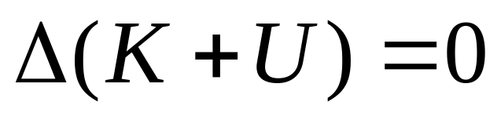
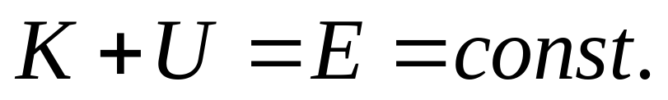
Without external forces
System K, U

Slide 3
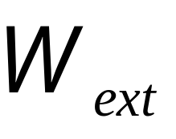
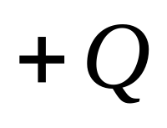
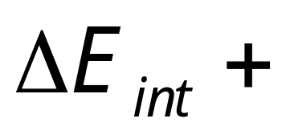
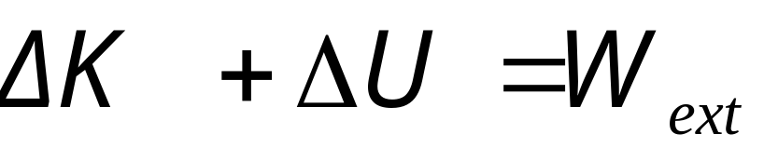
Work done on a system by external forces
Thermal Physics
System K, U
Mechanical Energy

Slide 4
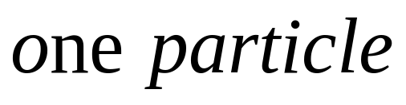
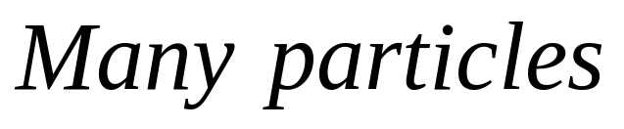
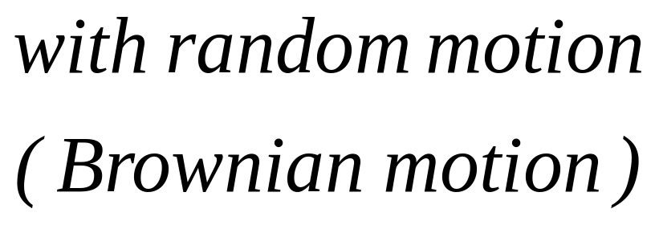
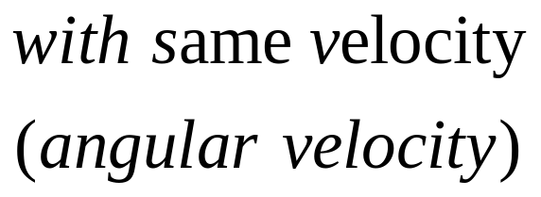
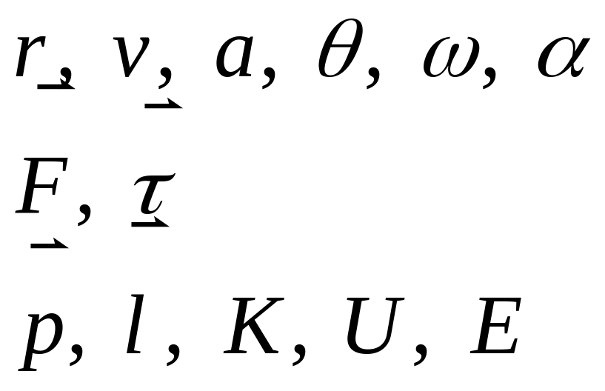


Thermal Physics
Mechanical Physics
?

Slide 5
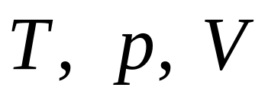
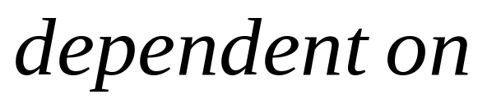
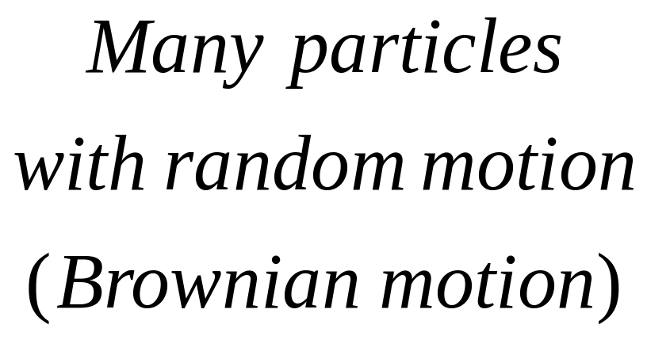
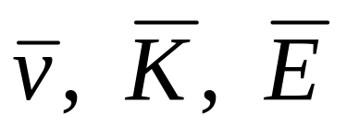
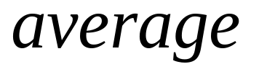
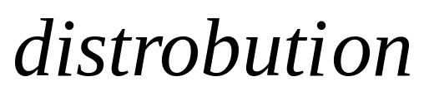
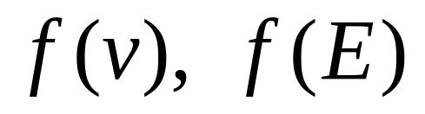
Macroscopic
Thermal Physics
Microscopic

Slide 6
Concept of Temperature
System of Temperature
Measuring of Temperature

Slide 7
Temperature systems:
— Kelvin temperature
— Celsius temperature
— Fahrenheit temperature

Slide 8
— Kelvin temperature
Absolute zero as zero
Water
Ice
Triple-point
Vapor
Triple-point as 273.16K

Slide 9
— Celsius temperature
T_{c}=T-273.15
— Fahrenheit temperature
T_{F}=(9/5)T_{c}+32

Slide 10












Boiling of Water
Freezing of Water
Boiling of LN
Absolute zero
Kelvin
Celsius
Fahrenheit

Slide 11
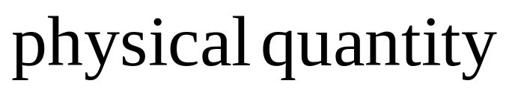
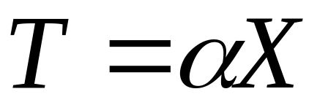
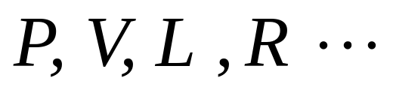

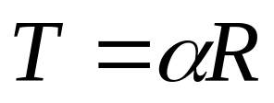

Measuring temperature with physical quantity proportional to T:
thermoresistance
R
G

Slide 12

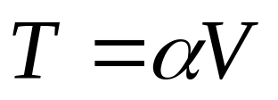
Measuring temperature with physical quantity proportional to T:
thermocouple
NiAl
V
NiCrAl

Slide 13

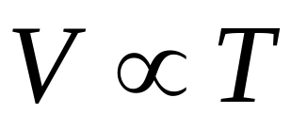
Measuring temperature with physical quantity proportional to T:
Constant Volume Gas Thermometer:
Constant Pressure Solid Thermometer:

Slide 14
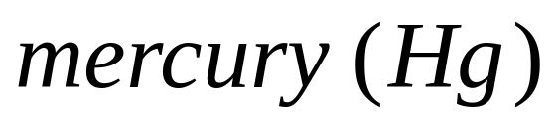
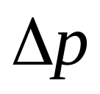
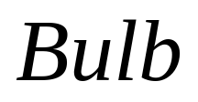
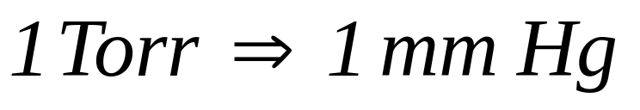
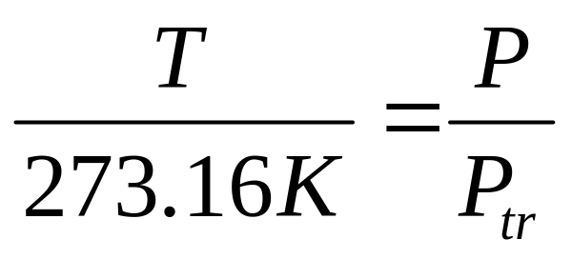
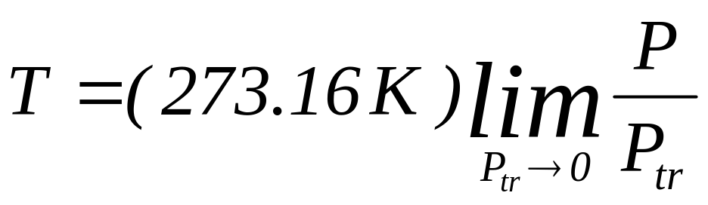
Constant Volume Gas Thermometer:

Slide 15
Thermal Equilibrium
Thermal Contact:
Thermal insulating
Thermal Conducting
T_{A}
A
T_{B}
B
T_{A}
A
T
A
Q
T_{B}
B
T
B
T_{A}=T T_{B} =T
T_{A}< T_{B}
The zeroth law of thermaldynamic

Slide 16
Thermal expansion
amount of expansion depends on…
  change in temperature
  original length
  coefficient of thermal expansion

Slide 17
Temp: T
L₀

Slide 18
Temp: T
L₀
Temp: T+ΔT
ΔL
    ΔL = α L₀ ΔT (linear expansion)
    ΔA = γ A₀ ΔT (area expansion)
    ΔV = β V₀ ΔT (volume expansion)

Slide 19
    ΔA = γ A₀ ΔT (area expansion)
    L=L₀+ΔL =L₀ + α L₀ ΔT
    L²=(L₀+ΔL) ² =(L₀ + α L₀ ΔT) ²
    =L₀ ² + 2α L₀ ² ΔT+(α L₀ ΔT) ²
    =L₀ ² + 2α L₀ ² ΔT
    A=A₀+ΔA =A₀ + γ A₀ ΔT
    γ =2α
    ΔV = β V₀ ΔT (Volume expansion)
    L ³ =L₀ ³ + 3α L₀ ³ ΔT
    β =3α

Slide 20
Microscopic of Thermal Expansion
When temperature rises
  molecules have more kinetic energy
    they are moving faster, on the average
  consequently, things tend to expand

Slide 21
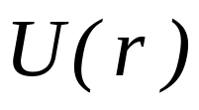
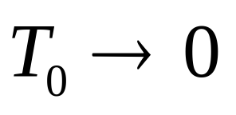
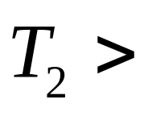
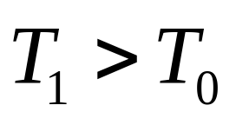
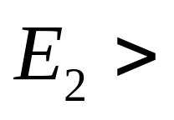
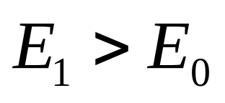
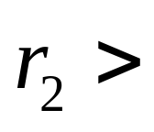
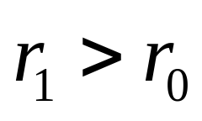
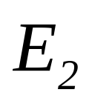

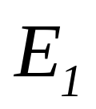
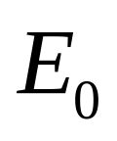




Slide 22
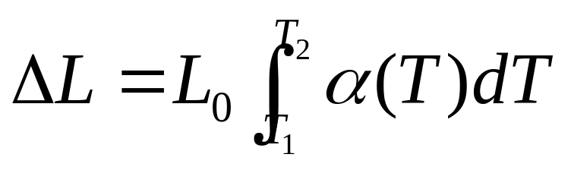
Temp: T
L₀
Temp: T+ΔT
ΔL
    ΔL = α L₀ ΔT (linear expansion)
    α = α (T)

Slide 23
Thermal Expansion
T = 0 C
T = 100 C
Most objects DO expansion with T

Slide 24
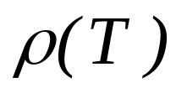

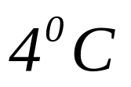
Thermal Expansion
T = 0 C
T = 100 C
Most objects DO expansion with T
Water has a maximum density at 4⁰C

Slide 25
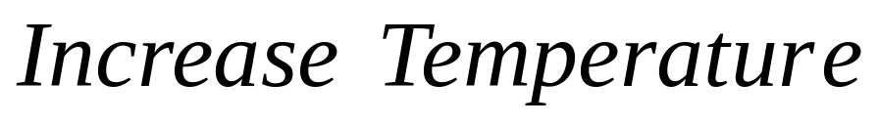
Bimetallic Strip

Slide 26
Bimetallic Strip

Slide 27
Bimetallic Strip

Slide 28
220V

Slide 29
220V

Slide 30

The Ideal Gas
The number of particles is “large”
All particles are in random motion
The volume of the particles is small
There is no interaction between them
The collision is perfectly elastic

Slide 31
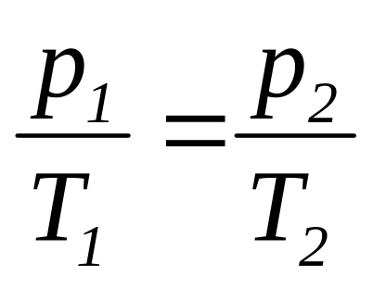
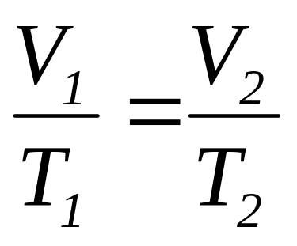
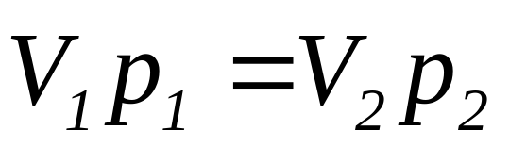
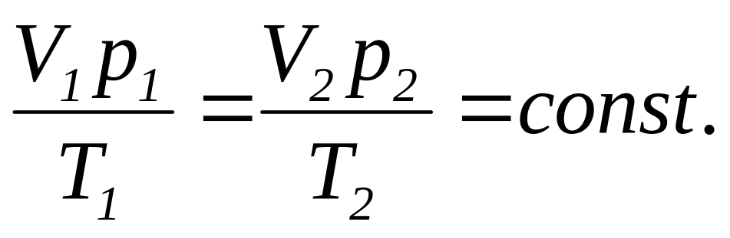
V=const.
p=const.
T=const.

Slide 32
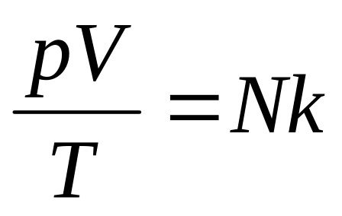



The Ideal Gas

Slide 33








The Ideal Gas

Slide 34
The Ideal Gas
The Ideal Gas
The real Gas
The number of particles is “large”
All particles are in random motion
The volume of the particles is small
The volume of the particles is not small
There is interaction between them
There is no interaction between them
The collision is perfectly elastic

Slide 35

The Ideal Gas
The real Gas

Slide 36
CHAP. 21 Problems
P493 1, 4
P494 8, 10, 11

